Slide 1
Coagulation and
Flocculation in Water Treatment
J(Hans) van Leeuwen
water treatment

Slide 2
Introduction
The need to clarify water
Aesthetics and health
Colloids – impart color and turbidity to water – aesthetical acceptability
Microbes are colloids too
water treatment

Slide 3
COAGULATION & FLOCCULATION
Removal of colloidal substances from water
Potable water requirements
health, aesthetics, economic
Colloids
Size of colloids - light waves
Brownian motion
Stability of colloids
water treatment

Slide 4
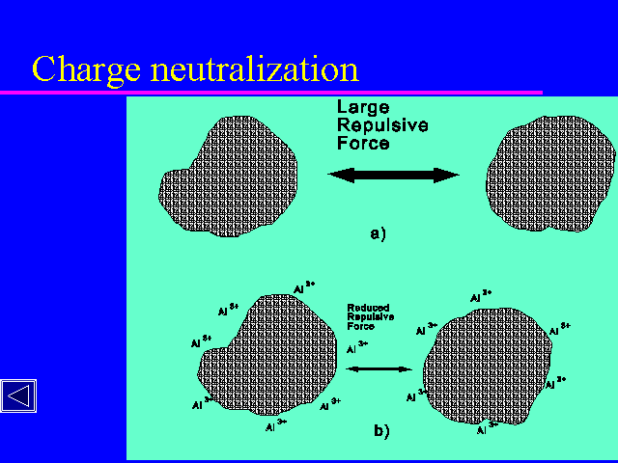
What is Coagulation?
Coagulation is the destabilization of colloids by addition of
chemicals that neutralize the negative charges
The chemicals are known as coagulants, usually higher valence
cationic salts (Al³⁺, Fe³⁺ etc.)
Coagulation is essentially a chemical process
-
-
-
-
-
-
-
-
-
-
-
-
-
-
-
-
-
-
-
-
-
-
-
-
-
-
-
-
water treatment

Slide 5
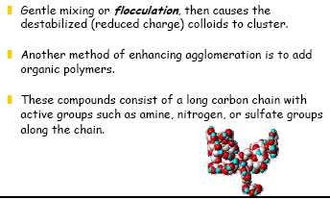
What is Flocculation?
Flocculation is the agglomeration of destabilized particles into
a large size particles known as flocs which can be effectively removed
by sedimentation or flotation.
water treatment

Slide 6
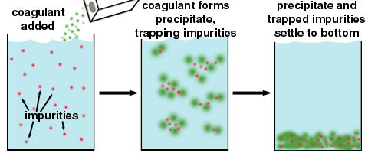
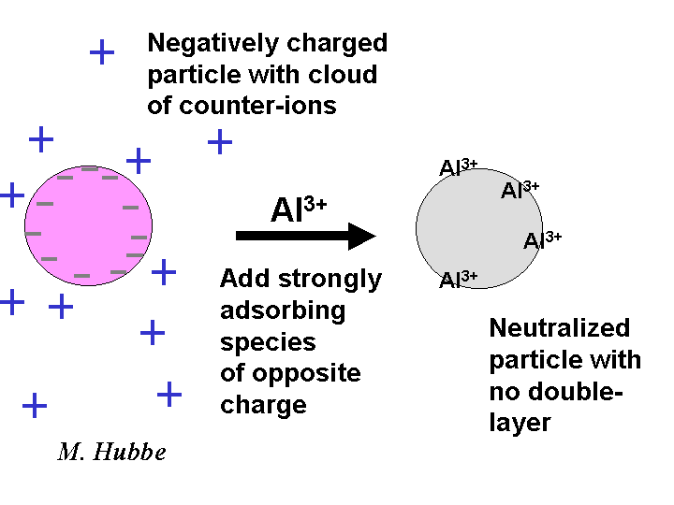
Coagulation aim
water treatment

Slide 7
Why coagulation and flocculation?
Various sizes of particles in raw water
Particle diameter (mm) Type Settling velocity
10 Pebble 0.73 m/s
1 Course sand 0.23 m/s
0.1 Fine sand 0.6 m/min
0.01 Silt 8.6 m/d
0.0001 (10 micron) Large colloids 0.3 m/y
0.000001 (1 nano) Small colloids 3 m/million y
G r a v I t y s e t t l I n g
Colloids – so small: gravity settling not possible
water treatment

Slide 8
Colloid Stability
Colloid
H₂O
Colloids have a net negative surface charge
Electrostatic force prevents them from agglomeration
-
-
-
-
-
-
-
-
Repulsion
-
-
-
-
Colloid - A
Colloid - B
Brownian motion keeps the colloids in suspension
Impossible to remove colloids by gravity settling
water treatment

Slide 9
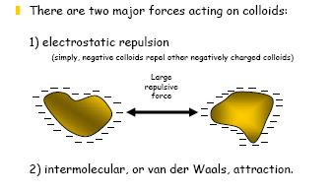
Colloidal interaction
water treatment

Slide 10
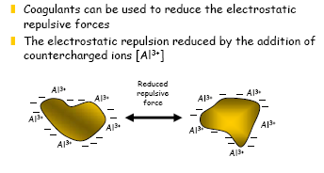
Charge reduction
water treatment

Slide 11
Colloid Destabilization
Colloids can be destabilized by charge neutralization
Positively charges ions (Na+, Mg2+, Al3+, Fe3+ etc.) neutralize the colloidal negative charges and thus destabilize them.
With destabilization, colloids aggregate in size and start to settle
water treatment

Slide 12
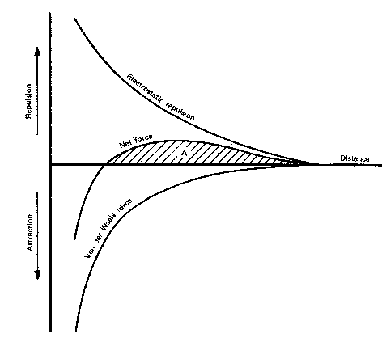
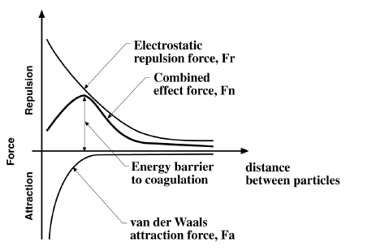
Force analysis on colloids
The integral of the combined forces is the energy barrier
water treatment

Slide 13
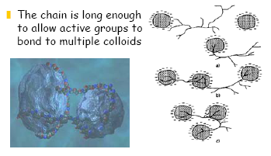
Flocculation aids
water treatment

Slide 14
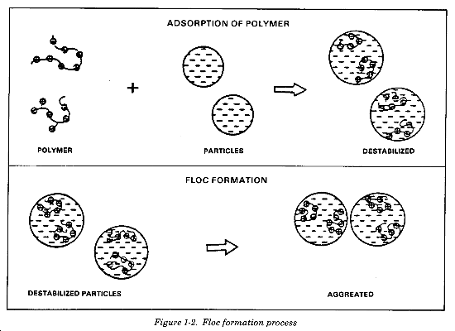
Floc formation with polymers
water treatment

Slide 15
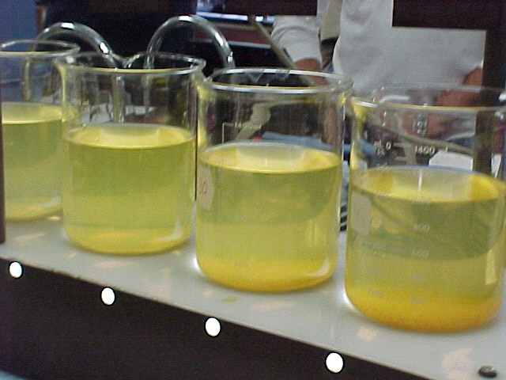
Jar Tests
The jar test – a laboratory procedure to determine the optimum pH
and the optimum coagulant dose
A jar test simulates the coagulation and flocculation processes
Determination of optimum pH
Fill the jars with raw water sample
(500 or 1000 mL) – usually 6 jars
Adjust pH of the jars while mixing
using H₂SO₄ or NaOH/lime
(pH: 5.0; 5.5; 6.0; 6.5; 7.0; 7.5)
Add same dose of the selected
coagulant (alum or iron) to each jar
(Coagulant dose: 5 or 10 mg/L)
Jar Test
water treatment

Slide 16
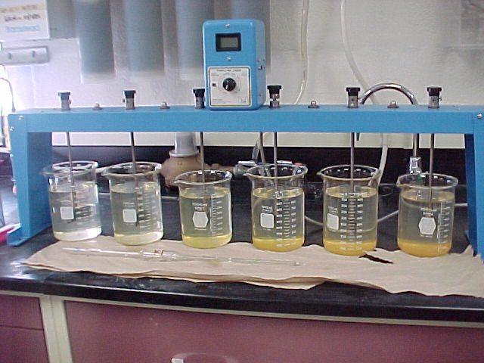
Jar Tests – determining optimum pH
Rapid mix each jar at 100 to 150 rpm for 1 minute. The rapid mix
helps to disperse the coagulant throughout each container
Reduce the stirring speed to 25 to 30 rpm
and continue mixing for 15 to 20 mins
This slower mixing speed helps
promote floc formation by
enhancing particle collisions,
which lead to larger flocs
Turn off the mixers and allow
flocs to settle for 30 to 45 mins
Measure the final residual
turbidity in each jar
Plot residual turbidity against pH
Jar Test set-up
water treatment

Slide 17
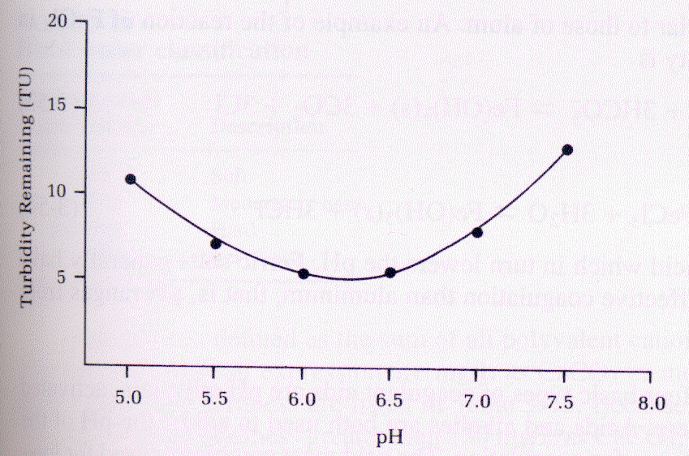
Jar Tests – optimum pH
Optimum pH: 6.3
water treatment

Slide 18
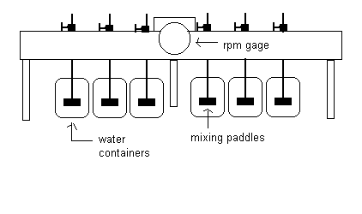
Optimum coagulant dose
Repeat all the previous steps
This time adjust pH of all jars at
optimum (6.3 found from first test)
while mixing using H₂SO₄ or
NaOH/lime
Add different doses of the selected
coagulant (alum or iron) to each jar
(Coagulant dose: 5; 7; 10; 12; 15; 20 mg/L)
Rapid mix each jar at 100 to 150 rpm for 1 minute. The rapid
mix helps to disperse the coagulant throughout each container
Reduce the stirring speed to 25 to 30 rpm for 15 to 20 mins
water treatment

Slide 19
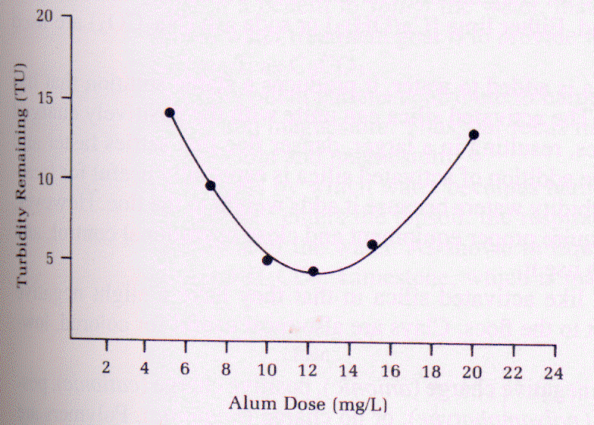
Optimum coagulant dose
Turn off the mixers and allow flocs to settle for 30 to 45 mins
Then measure the final residual turbidity in each jar
Plot residual turbidity
against coagulant dose
Optimum coagulant dose: 12.5 mg/L
The coagulant dose with
the lowest residual
turbidity will be the
optimum coagulant dose
water treatment
Coagulant Dose mg/L

Slide 20
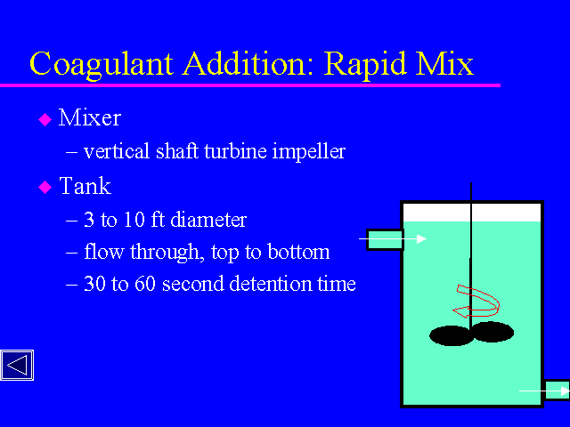
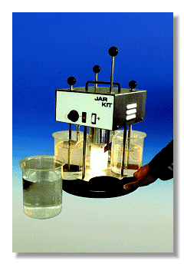
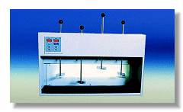
water treatment

Slide 21
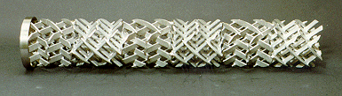
Hydraulic Jump: Hydraulic Jump creates turbulence and
thus help better mixing.
Coagulant
In-line flash mixing
Mechanical mixing
Back mix impeller flat-blade impeller
Inflow
Chemical
feeding
Chemical
feeding
Inflow
water treatment

Slide 22
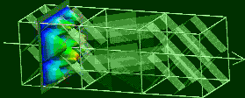
water treatment

Slide 23
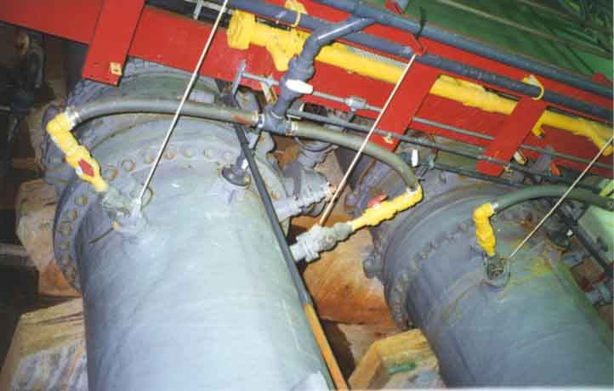
water treatment

Slide 24
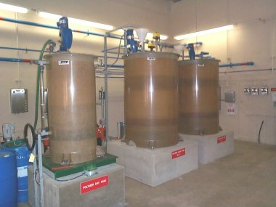
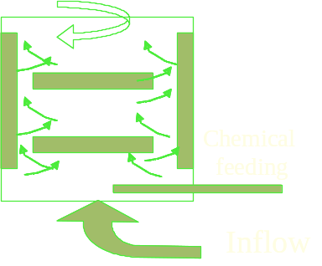
water treatment

Slide 25
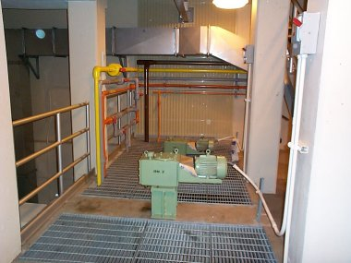
water treatment

Slide 26
Relative coagulating power
Na⁺ = 1; Mg²⁺ = 30
Al³⁺ > 1000; Fe³⁺ > 1000
Typical coagulants
Aluminum sulfate: Al₂(SO4)₃.14 H₂O
Iron salt- Ferric sulfate: Fe₂(SO4)₃
Iron salt- Ferric chloride: Fe₂Cl₃
Polyaluminum chloride (PAC): Al₂(OH)₃Cl₃
water treatment

Slide 27
Aluminum Chemistry
With alum addition, what happens to water pH?
Al₂(SO4)₃.14 H₂O ⇔ 2Al(OH)₃↓+ 8H₂O + 3H₂SO₄⁻²
1 mole of alum consumes 6 moles of bicarbonate (HCO₃⁻)
Al₂(SO4)₃.14 H₂O + 6HCO₃⁻ ⇔ 2Al(OH)₃↓+ 6CO₂ + 14H₂O + 3SO₄⁻²
If alkalinity is not enough, pH will reduce greatly
Lime or sodium carbonate may be needed to neutralize the acid.
(Optimum pH: 5.5 – 6.5)
water treatment

Slide 28
Al³⁺ species as a function of pH
water treatment

Slide 29
Alkalinity calculation
If 200 mg/L of alum to be added to achieve complete coagulation. How much alkalinity is consumed in mg/L as CaCO₃?
Al₂(SO₄)₃.14 H₂O + 6HCO₃⁻ ⇔ 2Al(OH)₃↓+ 6CO₂ + 14H₂O + 3SO₄⁻²
594 mg 366 mg
594 mg alum consumes 366 mg HCO₃⁻
200 mg alum will consume (366/594) x 200 mg HCO₃⁻
= 123 mg HCO₃⁻
Alkalinity in mg/L as CaCO₃ = 123 x (50/61)
= 101 mg/L as CaCO₃
water treatment

Slide 30
Iron Chemistry
FeCl₃+ 3HCO₃⁻ ⇔ Fe(OH)₃↓+ 3CO₂ + 3Cl⁻
With iron salt addition, what happens to water pH?
(Wider pH range of: 4 – 9; Best pH range of 4.5 – 5.5)
1 mole of FeCl₃ consumes 3 moles of bicarbonate (HCO₃⁻)
If alkalinity is not enough, pH will reduce greatly due to hydrochloric acid formation. Lime or sodium carbonate may be needed to neutralize the acid. Lime is the cheapest.
Exercise: Alkalinity calculation
If 200 mg/L of ferric chloride is added for coagulation, how much alkalinity is consumed in mg/L as CaCO₃?
water treatment

Slide 31
Fe species as a function of pH
water treatment

Slide 32
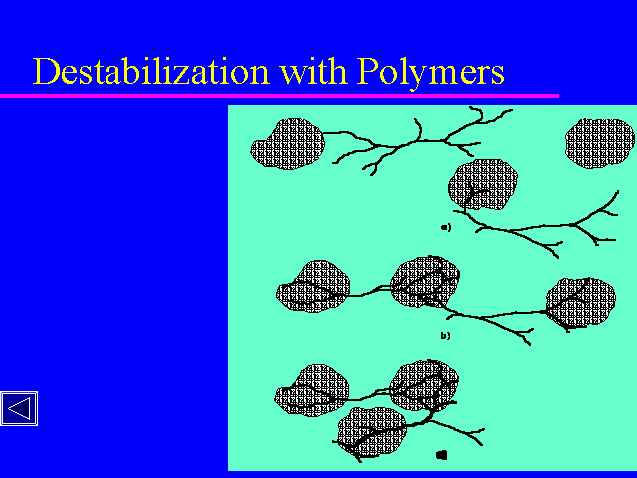
COAGULANT AIDS
Other substances than
coagulants used:
- Clay minerals
- Silicates
Polymers
Polymers are often
either anionic or
cationic to aid
coagulation.
Polymers also
reinforce flocs
water treatment

Slide 33
^{FLOCCULATION}
Flocculation - agglomeration of colloids by collisions to form separable flocs
Examples - milk, blood, seawater
Mechanisms - perikinetic, collisions from Brownian motion
- orthokinetic, induced collisions through stirring
Orthokinetic flocculation
Velocity gradient, relative movement between colloids in a fluid body RMS velocity gradient
Camp No. Gt Typical 2x 10⁴ - 10⁵
water treatment

Slide 34
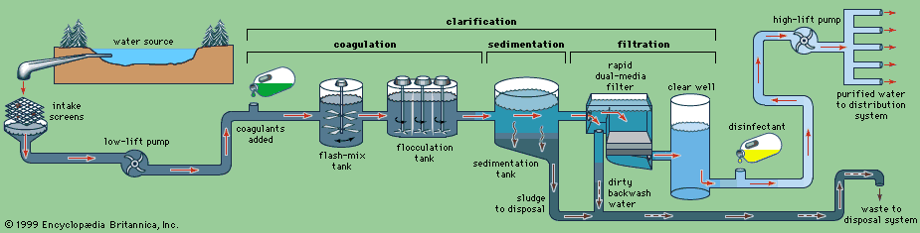
Typical layout of a water treatment plant
water treatment

Slide 35
Topics of Discussion
The place of flocculation within a water treatment process
The use of coagulation and flocculation in the water industry
Softening
Separation of flocs by settling
and flotation
water treatment

Slide 36
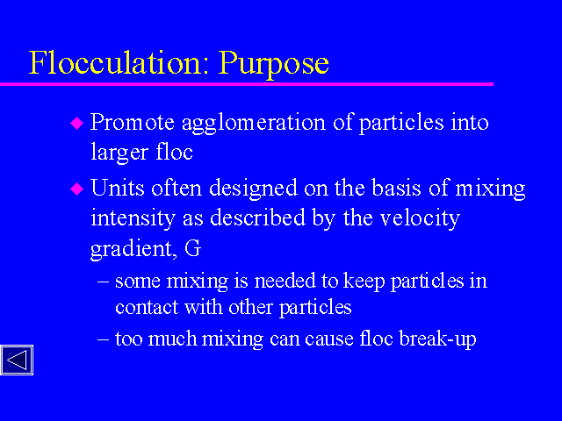
water treatment

Slide 37
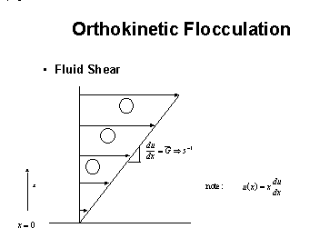

Slide 13 of 27
water treatment

Slide 38
Design of Flocculator (Slow & Gentle mixing)
Flocculators are designed mainly to provide enough interparticle contacts to achieve particles agglomeration so that they can be effectively removed by sedimentation or flotation
Transport Mechanisms
Brownian motion: for relatively small particles
which follow random motion and collide with
other particles (perikinetic motion)
Differential settling: Particles with different
settling velocities in the vertical alignment collide
when one overtakes the other (orthokinetic motion)
water treatment

Slide 39
Mechanical Flocculator
L
H
Transverse paddle
Cross flow Flocculator (sectional view)
W
Plan (top view)
water treatment

Slide 40
Hydraulic Flocculation
Horizontally baffled tank
L
The water flows horizontally.
The baffle walls help to create
turbulence and thus facilitate mixing
W
Plan view (horizontal flow)
Vertically baffled tank
The water flows vertically. The baffle walls help to create turbulence and thus facilitate mixing
H
L
Isometric View (vertical flow)
water treatment

Slide 41
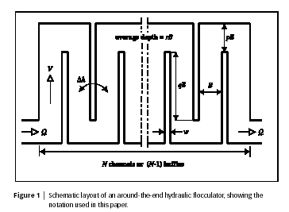
Hydraulic Flocculation
http://www.environmental-center.com/magazine/iwa/jws/art4.pdf
water treatment

Slide 42
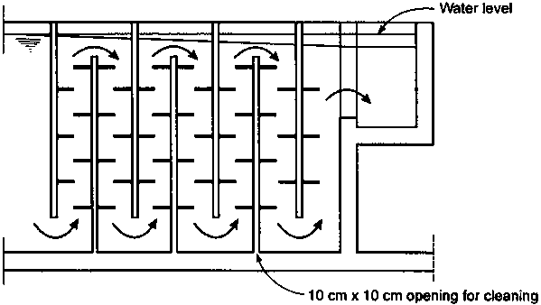
Hydraulic flocculators
water treatment

Slide 43
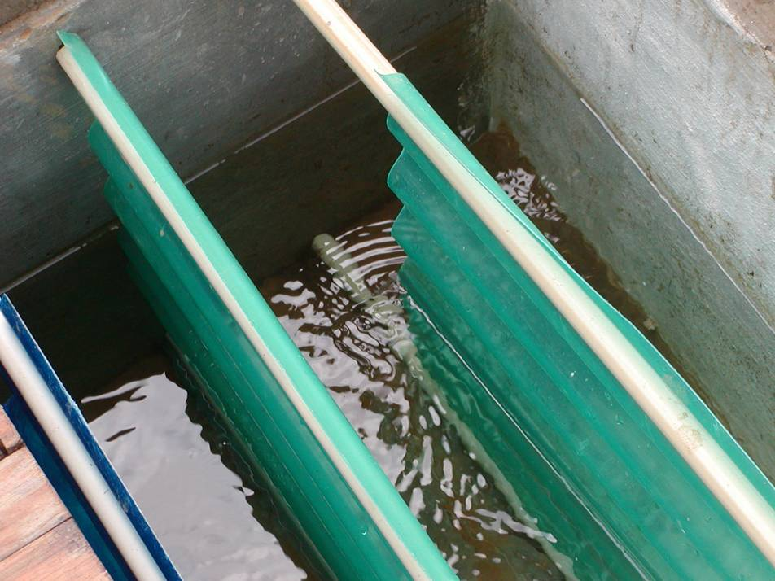
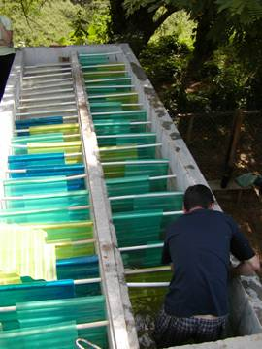
Hydraulic flocculators: simple technology
water treatment

Slide 44
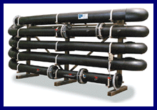

Hydraulic Flocculation: Pipe
water treatment

Slide 45
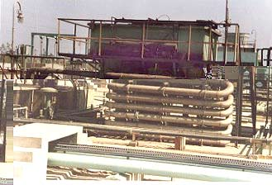
Hydraulic Flocculation: Pipe
water treatment

Slide 46
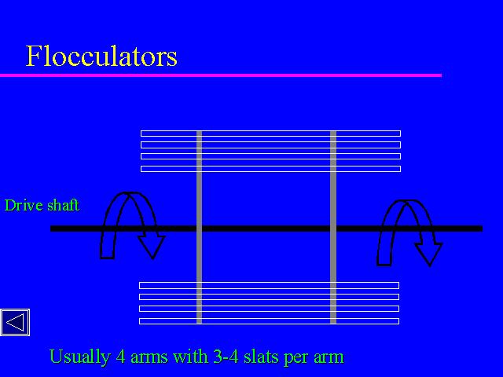
Hydraulic Flocculation:Large stirrers
water treatment

Slide 47
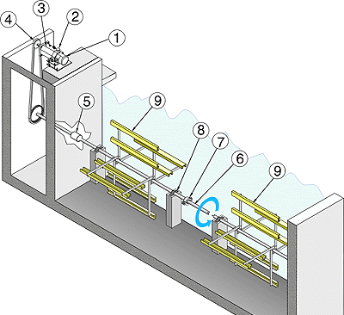
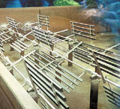
Mechanical flocculators
water treatment

Slide 48
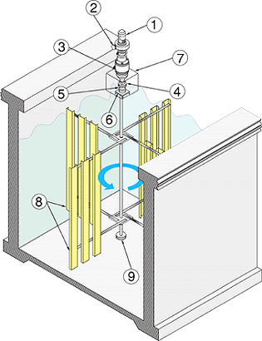
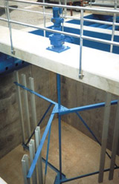
Mecahnical flocculators
water treatment

Slide 49
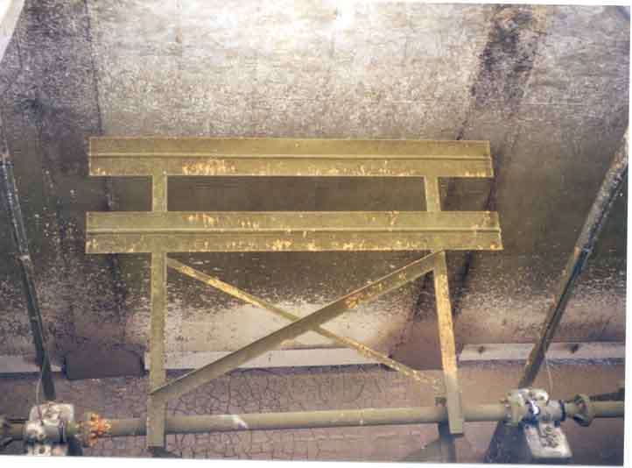
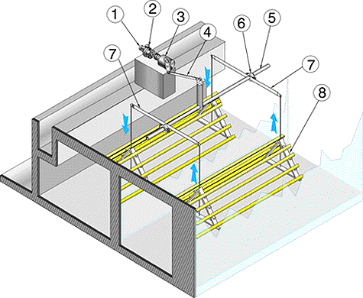
Mechanical flocculators
water treatment

Slide 50
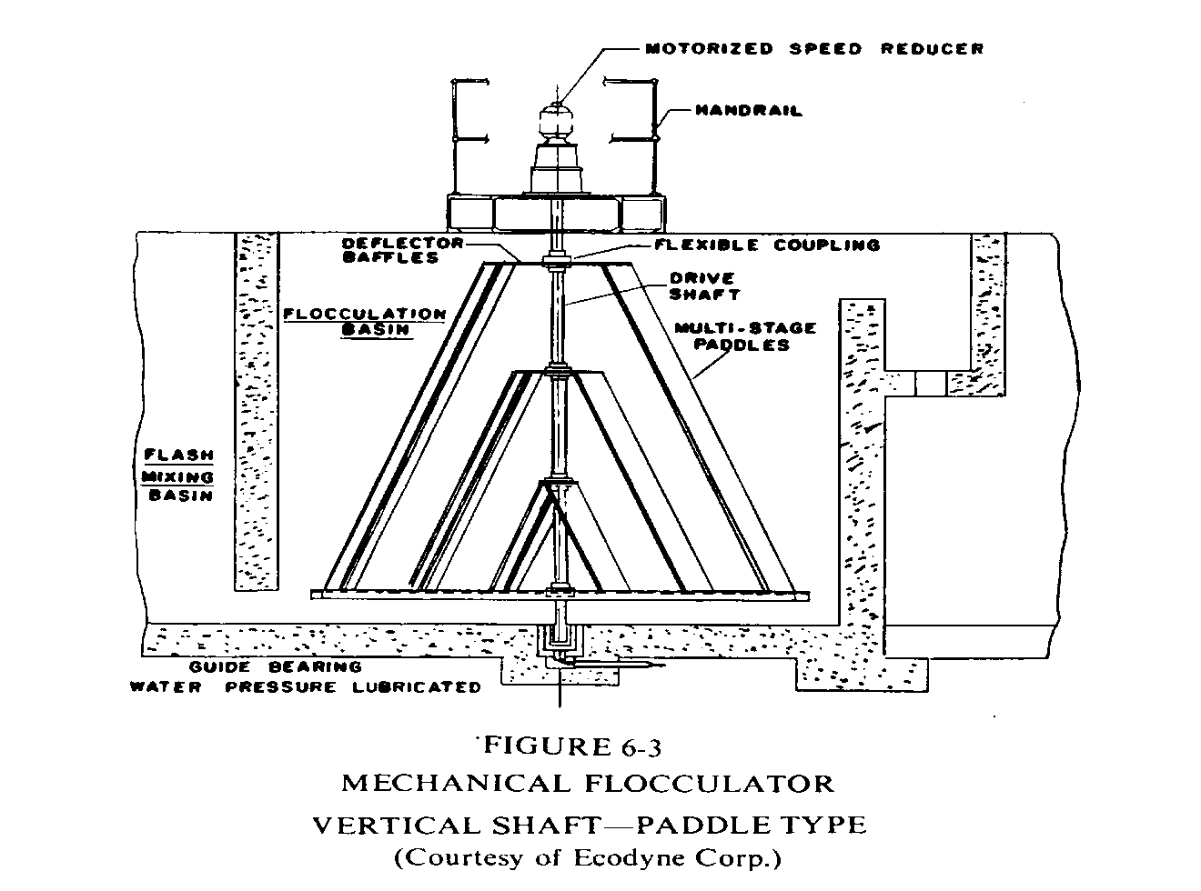
Another mechanical flocculator
water treatment

Slide 51
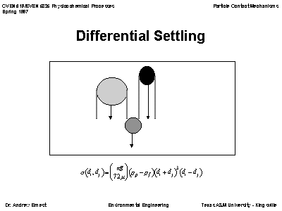
Differential settling flocculation
Slide 26 of 27
water treatment

Slide 52
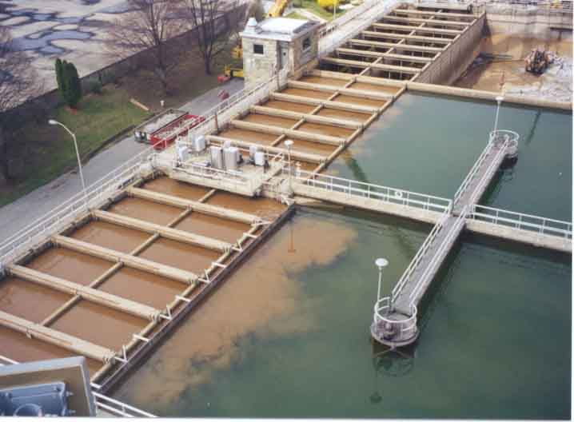
Flocculators integrated with settling
water treatment

Slide 53
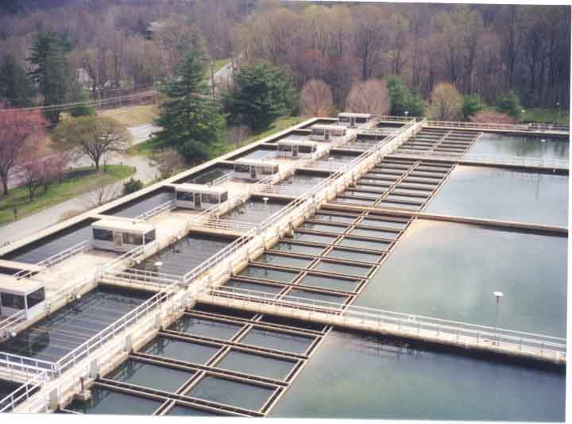
Flocculators integrated with settling
water treatment

Slide 54
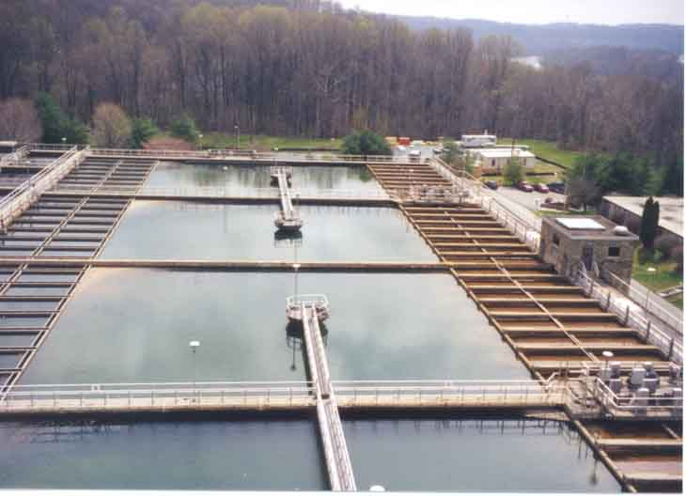
Flocculators both sides of settling
water treatment

Slide 55
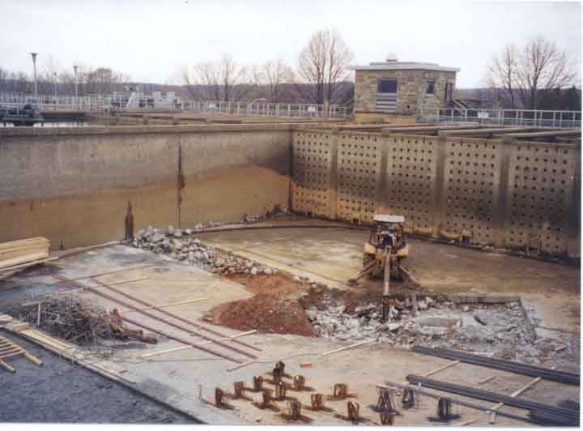
Flocculator perforated wall (in background)
water treatment

Slide 56
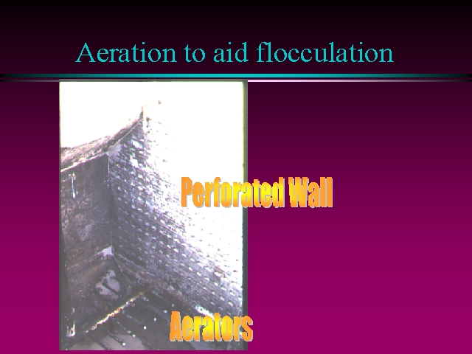
water treatment

Slide 57
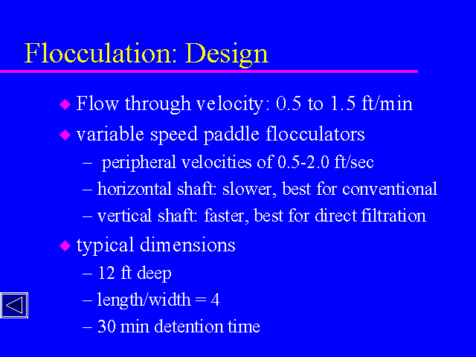
water treatment

Slide 58

Mixing and Power
The degree of mixing is measured by Velocity Gradient (G)
Higher G value, intenser mixing
Velocity Gradient: relative velocity of the two fluid particles/distance
G = dv/dy = 1.0/0.1 = 10 s⁻¹
In mixer design, the following equation is useful
0.1 m
G= velocity gradient, s^{-1;}
P = Power input, W
V = Tank volume, m³;
μ = Dynamic viscosity, (Pa.s)
1 m/s
water treatment

Slide 59
G value for coagulation: 700 to 1000 S⁻¹; 3000 to 5000 S⁻¹ for
Mixing time: 30 to 60 S in-line blender; 1-2 sec
G value for flocculation: 20 to 80 S⁻¹;
Mixing time: 20 to 60 min
In the flocculator design, Gt (also known Camp No.); a product of G and t is commonly used as a design parameter
Typical Gt for flocculation is 2 x 10⁴ - 10⁵
Large G and small T gives small but dense floc
Small G and large T gives big but light flocs
We need big as well as dense flocs
which can be obtained by designing
flocculator with different G values
G1:40
G2:30
G3:20
1
2
3
water treatment

Slide 60
Power Calculation
What horsepower level do we need to supply to a flocculation basin to provide a G value of 100s⁻¹ and a Gt of 100,000 for 10 MGD flow? (Given: μ = 0.89 x 10⁻³ Pa.s; 1 hp = 745.7 watts)
Solution:
Retention time, t = Gt/G = 100,000/100 = 1000 secs
Volume of Flocculation basin, V = (0.438 m³/sec) x (1000 sec) = 438 m³
P = G² V x μ
= 100² x 438 x 0.89 x10⁻³ = 3900 W
= 3900/746 = 5.2 hp
water treatment

Slide 61
WATER TREATMENT ENERGY CALCULATIONS
F = ma. In a gravity field, F = mg
Force in N, where a N is the force to accelerate 1kg @1m/s²
Force to move h, Potential energy = Fh = mgh
Dimensions MLT⁻²L, kgm²s⁻² = Nm or J
Force moving at a certain speed, introduces time dimension
Dimensions here are MT⁻¹, L/s (1L=1kg)
Rate of energy usage, or power, P = mgh/t
Dimensions are now ML²T⁻³, or kgm²s⁻³ = J/s or W.
Power (W) to pump water to h, flow rate in L/s (or kg/s)
W = kg/s x h x 9.8 m/s²
kW, divide by 1000 HP, divide by 746
water treatment

Slide 62
VISCOSITY MEASUREMENT
Viscosity of water is a measure of its resistance to flow
The cgs unit is the Poise, 1 gcm⁻¹s⁻¹. Water viscosity is c. 1cP = 0.01P = 0.001 Pa.s
Pa = N/m² or kgms⁻²m⁻², so Pa.s = kgms⁻²m⁻²s = kgm⁻¹s⁻¹
This could also have been derived from going from gcm⁻¹s⁻¹, multiplying by 100/1000.
Therefore 1cP = 0.001kgm⁻¹s⁻¹
water treatment

Slide 63
Calculation of Velocity Gradient
Calculate the velocity gradient in a flocculator, where
the required energy is 1 J/L. Flow rate is 4ML/d, retention time = 20 min
Volume, V = 4000/(24 x 60/20) = 55.5 m³
Flow rate = 4000 x 1000 = 46.3 L/s
24 x 60 x 60
_____ _________________
G = √ P/Vμ = √ 1 x 46.3/0.001x55.5
= 28 s⁻¹
water treatment

Slide 64
Calculate height required for hydraulic flocculator
Calculate the head difference in water through a
hydraulic flocculator, where the required energy
input is 1 J/L and the flow rate is 4 ML/d.
Power = energy/time
1 J x L/s = kg/s x 9.8 x h
Therefore, h = 1/9.8 m
= 0.102m
water treatment

Slide 65
Calculate Camp No
Calculate the Camp No for the hydraulic
flocculator in the previous example
Camp No = G.t
= 28 x 20 x 60
= 33,000
(within the boundaries of 20,000 – 200,000)
water treatment

Slide 66

PADDLE FLOCCULATORS
F = C_{D}Aρν²/2
Where F = drag force, N
C_{D} = dimensionless drag coefficient for plates moving faces normal to direction of motion
A = cross-sectional area of the paddles, m²
υ = relative velocity between paddles and fluid, m/s
ρ = density, 1000 kg/m³
The power input can be computed as the product of drag force and velocity:
P = Fυ = C_{D}Aρν³/2
If this is substituted in the equation for G, the mean velocity gradient G becomes
G² = P/μV = C_{D}Aρν³/ 2μV
water treatment

Slide 67
What you need to know
How to determine the velocity gradient and volume, chemical and energy requirements for flocculation
Be able to size settling tanks on the basis of particle settling rates and identify important zones in the settling tank
Softening calculations
water treatment

Slide 68
Disinfection Byproducts: A Reference Resource
Disinfection byproducts are formed when disinfectants used in water treatment plants react with bromide and/or natural organic matter (i.e., decaying vegetation) present in the source water. Different disinfectants produce different types or amounts of disinfection byproducts. Disinfection byproducts for which regulations have been established have been identified in drinking water, including trihalomethanes, haloacetic acids, bromate, and chlorite. ------------------------
Trihalomethanes (THM) are a group of four chemicals that are formed along with other disinfection byproducts when chlorine or other disinfectants used to control microbial contaminants in drinking water react with naturally occurring organic and inorganic matter in water. The trihalomethanes are chloroform, bromodichloromethane, dibromochloromethane, and bromoform. EPA has published the Stage 1 Disinfectants/Disinfection Byproducts Rule to regulate total trihalomethanes (TTHM) at a maximum allowable annual average level of 80 parts per billion. This standard replaced the current standard of a maximum allowable annual average level of 100 parts per billion in December 2001 for large surface water public water systems. The standard became effective for the first time in December 2003 for small surface water and all ground water systems. ------------------------
Haloacetic Acids (HAA5) are a group of chemicals that are formed along with other disinfection byproducts when chlorine or other disinfectants used to control microbial contaminants in drinking water react with naturally occurring organic and inorganic matter in water. The regulated haloacetic acids, known as HAA5, are: monochloroacetic acid, dichloroacetic acid, trichloroacetic acid, monobromoacetic acid, and dibromoacetic acid. EPA has published the Stage 1 Disinfectants/Disinfection Byproducts Rule to regulate HAA5 at 60 parts per billion annual average. This standard became effective for large surface water public water systems in December 2001 and for small surface water and all ground water public water systems in December 2003. -------------
Bromate is a chemical that is formed when ozone used to disinfect drinking water reacts with naturally occurring bromide found in source water. EPA has established the Stage 1 Disinfectants/Disinfection Byproducts Rule to regulate bromate at annual average of 10 parts per billion in drinking water. This standard will become effective for large public water systems by December 2001 and for small surface water and all ground public water systems in December 2003. ------------------------
Chlorite is a byproduct formed when chlorine dioxide is used to disinfect water. EPA has published the Stage1 Disinfectants/Disinfection Byproducts Rule to regulate chlorite at a monthly average level of 1 part per million in drinking water. This standard became effective for large surface water public water systems in December 2001 and for small surface water and all ground water public water systems in December 2003
water treatment

Slide 69
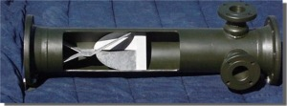

water treatment

Slide 70

water treatment

